Slide 1


Student and School Success
May 31st, 2016
Michael Merrin, Assistant Superintendent
Craig Shurick, Director of Operations
Office of Student and School Success (OSPI)

Slide 2
Goals
  Share a 10,000 foot View of:
  Who we are
  What we do
  Update on Student and School Success
    2016/2017
    ESSA Workgroup
  Questions
Notes:
Outcome:
Audience Response
Who is in the Room?
Roles
Geographic
Size Districts

Slide 3

If We Do…Then We Impact…That Results In…
OSSS SUPPORTS & SERVICES
Focus on Data-informed Instruction, Interventions, and Leadership Practices
Provide:
-Continuous Improvement Process:
-Recognition & Accountability and Assistance & Intervention
DISTRICT AND SCHOOL
STRATEGIC AREAS
Focus on Data-informed Instruction, Interventions, and Leadership Practices
Provide:
-Continuous Improvement Process:
-Recognition & Accountability and Assistance & Intervention
TRANSFORMATIONAL
TEACHING
FOR
LEARNING
SUCCESS
Equality in Outcome for Washington’s
1.1 Million Students
OUTCOMES
Equality in Outcome for Washington’s
1.1 Million Students
COURAGEOUS
LEADERSHIP
Notes:
The title for this graphic highlights the foundation for the Theory of Action: If we… (action), then we impact… (educator practice), that results in… (changes in student learning outcomes and educator practice).
The graphic depicts the catalytic levers of Courageous Leadership and Transformational Teaching for Learning that are essential to ensure Equality in Outcome for all students in Washington State.
The box at the top left emphasizes our state and regional focus on data-informed instruction, interventions, and leadership practices. Our supports and services are anchored in a continuous improvement process that includes several key steps. The steps for this iterative process include: Assess Need for Change, Identify Problems of Educator Practice that address recognized learning needs, Select Interventions, Create Action Plan to address identified learning needs and problems of educator practice, Implement the Plan, Monitor Progress using a variety of data, and revise the plan.
The box at the top right highlights the strategic areas of focus for both districts and schools. You’ll notice those parallel our state and regional areas of focus. Action planning and implementation of evidence-based practices at the state, regional, district, and school levels describe the “If we do…” portion of our Theory of Action. These actions are intended to impact both leadership and instructional practice.
Coherence and alignment across the four levels of the system-State, Regional, District, and School-will bring about the intended results of sustainable improvements in educator practice and student learning. When implemented in tandem and consistently across all four levels, these actions will result in the “Outcomes” and “Success” depicted in the bottom two boxes, that is, equality in outcome for all 1.1 million students across our state.

Slide 4
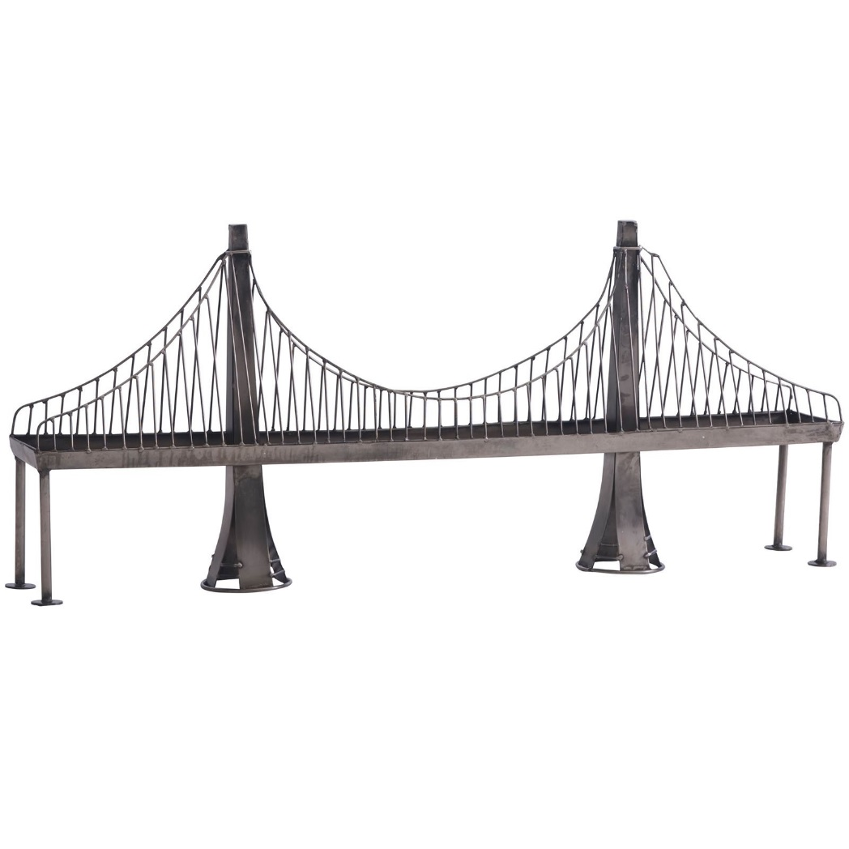
Sustainability
OSPI (OSSS)
Coaches
ESD’s
Policy Makers
Districts
Principals
Teachers
Students
Higher Education
Building Bridges

Slide 5
  Who We Serve:
  Priority and Focus Schools 2015-16
Title and Non-Title Schools
Data in each of 3 years (2012, 2013, & 2014)
At least 20 continuously enrolled (CE) students each year (N >=20)
ES and MS/JHS: Reading and Math
HS: Reading and Math AND/OR Graduation Rates
Notes:
Survey Model 15-16
End of year 2016 (Aug. 15-July 16)

Slide 6

Office of Student and School Success
Multi-Tiered Framework
All schools/districts begin at the “All Schools” tier and perform the actions listed.
All schools/districts identified as Priority/Focus/SIG/RADI/ RADII implement additional actions listed per designation.
REQUIRED ACTION DISTRICT LEVEL II
DIRECTED
REQUIRED ACTION DISTRICT LEVEL I
LESS LOCAL
ACTIONS
PRIORITY, FOCUS, AND SCHOOL IMPROVEMENT GRANT (SIG) SCHOOLS & DISTRICTS
AUTONOMY
TARGETED
MORE LOCAL
ALL SCHOOLS & DISTRICTS
STATE ACTIONS
SCHOOL & DISTRICT ACTIONS
SCHOOL & DISTRICT ACTIONS
STATE ACTIONS
RECOGNITION & ACCOUNTABILITY
ASSISTANCE & INTERVENTION
2-10-15 | dg
Notes:
MM/ We thought it helpful to describe where the schools we serve fit into the multi-tiered framework of services and supports offered .
This graphic illustrates the key components of our multi-tiered framework of services and supports. Note that state, district, and school-level actions describe the “If we do” portion of our Theory of Action.
Highlights include the following:
Supports and services at the state, district, and school levels are segmented into two categories: Recognition and Accountability and Assistance and Intervention.
Schools/districts are segmented into four tiers based on student performance on state assessments and graduation rates.
Similar to a multi-tiered system of supports, as performance decreases compared to other schools/districts in the state, the level of intensity of services, supports, and interventions increases.
Actions become more directed and autonomy shifts to less local control as the need for supports, services, and interventions increases. Likewise, as school performance improves over time, actions become less directed and autonomy shifts to more local control.
The next several slides describe specific supports, services, and interventions for each level of the graphic.

Slide 7
Service Models
Priority Schools
Focus Schools

Slide 8
Priority Schools
Identification: Bottom 5% based on All Students Group (Reading and Math State Assessments and/or Adjusted 5-Year Graduation Rates)
Total of 121 Priority schools for 2015-16: 27 New and 94 Continuing
Funding: $30,000 per school
Number of Leadership Coaching Days: 15 Days centered on:
  Creating, Implementing, and Monitoring/Revising Student and School Success Action Plan anchored in unique student and school needs
  Strengthening Core Instructional Program so at least 80% of students meet or exceed standard
  Using school’s data to surface and address inequitable learning outcomes and educator practices leading to those outcomes
  Applying evidence-based practices and research
* Allocated Coaching Days for Priority/Focus Schools: 15 days x 8 hours a day x $75/hour = $9,000

Slide 9
Focus Schools
Identification: Bottom 10% of Subgroups (based on Reading and Math) and/or Adjusted 5-Year Graduation Rates
Total of 133 Focus schools for 2015-16: 28 New and 105 Continuing
Funding: $20,000 per school
Number of Leadership Coaching Days: 15 Days centered on:
  Creating, Implementing, and Monitoring/Revising Student and School Success Action Plan anchored in unique student, subgroup, and school needs*
  Strengthening Core Instructional Program so at least 80% of students meet or exceed standard
  Using school’s data to surface and address inequitable learning outcomes and educator practices leading to those outcomes
  Applying evidence-based practices and research
  *Online action-planning tool (Indistar®) allows teams to select research-based practices that have the greatest success in meeting the needs of identified subgroups

Slide 10
School Improvement Grant (SIG) Schools
Identification: 13 schools and their districts in Cohort III
  Voluntary process to apply for SIG
  Only Priority Schools were eligible to apply (in bottom 5% based on All Students performance)
Funding: $729K - $6.9M
Number of Leadership Coaching Days: 30 Days centered on:
  Implementing identified federal intervention model (Transformation)
  Creating, Implementing, and Monitoring/Revising Student and School Success Action Plan anchored in unique student and school needs
  Strengthening Core Instructional Program so at least 80% of students meet or exceed standard
  Using school’s data to surface and address inequitable learning outcomes and educator practices leading to those outcomes
  Applying evidence-based practices and research
Notes:
SIG:
Our projected grant award for SIG is $8,040,708. Of this amount we have $6,903,881 aligned directly to the 13 SIG schools through grants and $729,177 aligned to other stuff (contractors who support the schools, meetings/trainings, indirects).

Slide 11
Required Action Districts (RAD) Schools
Identification: 4 RAD Cohort II and 1 RAD Cohort I continuing forward
  Districts recommended by OSPI to the State Board of Education (SBE) to enter required action status based on little or no growth on state assessments for identified schools for multiple years
Funding: $1.6M - $2.1M
Number of Leadership Coaching Days: 30 Days centered on:
  Implementing identified federal or state intervention model
  Creating, Implementing, and Monitoring/Revising Student and School Success Action Plan anchored in unique student and school needs
  Strengthening Core Instructional Program so at least 80% of students meet or exceed standard
  Using school’s data to surface and address inequitable learning outcomes and educator practices leading to those outcomes
  Applying evidence-based practices and research
Notes:
RAD:
Our projected award for state funds is $8,852,000. Of this amount we have potentially $2,134,000 aligned to RAD schools, $1,630,000 aligned to Priority/Focus schools through grants, $2,795,250 aligned to contractor who support the schools, and $394,000 aligned to meetings, trainings, and the CSA, and $1,898,750 sitting as a buffer to help with the projected deficient in Student and School Success funding for 2016-17.

Slide 12
Student and School Success Coaches
85 Success Coaches for 2015-16
  Leadership Coaches: 55
  Instructional Coaches: 30
Experienced Educators: Former teachers, principals, central office administrators, superintendents, and/or educational consultants
Training: Professional Learning for success coaches focuses on
  Strengthening core instructional program
  Using data to surface and address inequitable outcomes and practices leading to those outcomes
  Applying research- and evidence-based processes
Service Delivery and Accountability: Our office monitors coach visits and trainings, sets goals based on post-event and user evaluations, and reviews Student and School Success Action Plans to ensure alignment with evidence-based practices.
Notes:
This training includes:
Coaching for Equity (National Equity Project – Oakland, CA)
Coaching for School Improvement Handbook (Kathleen Laba)
Indistar® (Academic Development Institute ADI – Illinois)
Students with Disabilities (SWD)
Active Implementation (Dean Fixsen – University of North Carolina)
Multi-Tiered Systems of Support – both academic and behavioral
i.e., Positive Behavior Supports (PBIS)
Data Analysis and Facilitation of Data Dialogues
English Language Learners (ELL) – Program Models and Standards
Washington State Learning Standards and Smarter Balanced Assessments
Monitoring
Regional Improvement Network (RIN) and Content Improvement Network (CIN) (monthly) and Statewide Professional Learning Meetings (quarterly)
Indistar provides administrative and reporting features to monitor school progress and provide feedback
Data Driven – CEE (Center for Educational Effectiveness) to provide perceptual data – staff, parents, students, and communities. SEA Monitoring consists of Monthly CEE Data Huddles. We also have 2 Data Analyst Positions in our division – develop interactive reports that will give us the deeper disaggregation. When SBAC data is populated we will be able to dive to student/classroom level.

Slide 13
Differentiated Instructional Services
Students with Disabilities: Comprehensive Special Education School Review
  English and Language Arts
  Mathematics
  PBIS
    Positive
    Behavior
    Intervention
    Supports
  Academic Support Program Analysis, General Background, Summary of School Performance, Primary Intervention Systems (Tier I), Secondary and Tertiary Intervention Systems (Tier II and Tier III), Recommendations
English Language Learners: GLAD/SIOP Training, Co-Teaching Models
Collaboration to provide services based on unique student and school needs: OSPI Divisions (Student Support, Secondary Education, Title III [Migrant and Bilingual Education] and Teaching and Learning); Regional Educational Service Districts (ESDs), Center for Educational Effectiveness (CEE)

Slide 14
Collaboration
  Turn and Talk
  Share an important take-away from Presentation

Slide 15
ESSA Updates

Slide 16

Every Student Succeeds Act (ESSA)
•Signed into law on December 10, 2015.
•Reauthorizes the Elementary and Secondary Education Act of 1965 (ESEA) and replaces No Child Left Behind (NCLB).

Slide 17
Every Student Succeeds Act
Holds all students to high academic standards that prepare them for success in college and careers.
Ensures accountability and guarantees that when students fall behind, steps are taken to help them and their schools improve; focuses on the very lowest- performing schools, high schools with high dropout rates, and schools where subgroups are falling behind.
Continues to ensure that parents and educators have annual assessment information about how students are doing, while supporting states and districts in reducing unnecessary, onerous and redundant testing.
Empowers state and local decision-makers to develop their own strong systems for school improvement.
Protects students from low-income families, students of color, English learners, and students with disabilities from being taught at disproportionate rates by ineffective, inexperienced, and out of field teachers.

Slide 18
ESSA Implementation Timeline
Full implementation of ESSA is required beginning in the 2017─18 school year.
Department of Education is working on ESSA guidance.
  To date, no publication timeline has been provided.
Negotiated Rulemaking (March and April 2016)
  Supplement not Supplant
  Multiple Assessment Areas
U.S. Department of Education’s Frequently Asked Questions: Transitioning to the Every Student Succeeds Act (ESSA).

Slide 19
ESSA Consolidated Plan
SECTION 1111

Slide 20
Washington Shall Submit A Consolidated Plan That Is…
Developed by the state educational agency with timely and meaningful consultation with:
The Governor
Members of the State Legislature
State Board of Education
Districts (including rural)
Representatives of Tribes
Teachers, Principals, other School Leaders, Specialized Instructional Support Personnel, Paraprofessionals
Administrators
Parents
Section 1111(a)(1)(A)

Slide 21
Washington Shall Submit a Consolidated Plan That is—
Coordinated with:
Other programs under this Act
Individuals with Disabilities Education Act (20 U.S.C. 1400 et seq.)
Rehabilitation Act of 1973 (20 U.S.C. 701 et seq.)
Carl D. Perkins Career and Technical Education Act of 2006 (20 U.S.C. 2301 et seq.)
Workforce Innovation and Opportunity Act (29 U.S.C. 3101et seq.)
Head Start Act (42 U.S.C. 9831 et seq.)
Child Care and Development Block Grant Act of 1990 (42 U.S.C. 9858 et seq.)
Education Sciences Reform Act of 2002 (20 U.S.C. 9501 et seq.)
Education Technical Assistance Act of 2002 (20 U.S.C. 9601 et. seq.)
National Assessment of Educational Progress Authorization Act (20 U.S.C. 9621 et seq.)
McKinney-Vento Homeless Assistance Act (42 U.S.C. 11301 et seq.)
Adult Education and Family Literacy Act (29 U.S.C. 3271 et seq.)
Section 1111(a)(1)(B)

Slide 22
Coordination of Programs
CONSOLIDATED STATE AND LOCAL PLANS
The purposes are:
To improve teaching and learning by encouraging greater cross-program coordination, planning, and service delivery.
To provide greater flexibility to state and local authorities through consolidated plans, applications, and reporting.
To enhance the integration of programs under this Act with
state and local programs.
Section 8301

Slide 23
What Must Be Addressed In The Consolidated Plan
Challenging State Academic Standards
Alternate Academic Achievement Standards for Students with the Most Significant Cognitive Disabilities
English Language Proficiency Standards
Academic Assessments
Language Proficiency Assessments
Statewide Accountability System
School Support and Improvement Activities
Report Card
ESEA/ESSA Federal Programs
Coordination with non-ESSA programs

Slide 24
ESSA Consolidated Plan Timeline
OSPI must submit a Consolidated Plan to the U.S. Department of
Education for approval (tentatively scheduled for Nov 2016).
The ESSA Consolidated Plan must be sent out for public comment for at least 30 days before submission.
The Governor has 30 days to sign-off on the Consolidated Plan.
The U.S. Department of Education has 120 days to approve the plan.

Slide 25
So what about the 2016-17 school year?
  ESSA requires schools and districts identified by the State in 2015-16 as in need of improvement, corrective action, or restructuring under ESEA to continue to implement interventions in the 2016-17 school year.
    They are not required to offer Public School Choice, Supplemental Educational Services (SES), and the related notice to parents.
    They are required to provide alternative supports for SES-eligible students and for schools with the greatest need.

Slide 26
So what about the 2016-17 school year?
  ESSA removes the ESEA (NCLB) Highly Qualified Teacher requirements as of December 10, 2015.
    Go to http://www.k12.wa.us/ESEA/ESSA/HQT.aspx
  ESSA makes a significant change from “Highly Qualified” Teachers to “Effective” Teachers.
  State Plans to Ensure Equitable Access to Excellent Educators remain in effect.

Slide 27
U.S. Department of Education
Dear Colleague Letters
  ESSA Dear Colleague Letter (January 28, 2016)
  Dear Colleague Letter on the Transition to ESSA (December 18, 2015)
  Dear Colleague Letter on the New ESSA Law (December 10, 2015)

Slide 28
Collaboration
  Turn and Talk
  Share an important take-away from Presentation

Slide 29
Washington’s Approach to the ESSA Consolidated Plan

Slide 30
WA ESSA Consolidated Plan Organizational Chart
 |  |  |  | Supt. of Public Instruction
OSPI ESSA Leadership Team
 |  |  | ESSA Consolidated Plan Team
Federal Programs (Lead: Gayle Pauley)
Account- ability System (Lead: Gil Mendoza
& Ben Rarick)
Teaching
& Learning (Lead: Kathe Taylor)
Student Assessment System (Lead: Robin Munson)
School & District Improvement (Lead: Michael Merrin)
Effective Educators (Lead: Maria Flores & Sue Anderson)
English Learners (EL)
(Lead: Mea Moore)
Fiscal (Lead: JoLynn Berge)
Report Card (Lead: Deb Came)
Parent & Community Engagement (Lead: Paula Moore)
Early Childhood Education (Lead: Bob Butts)
Students With Disabilities (SWD)
(Lead: Doug Gill)

Slide 31
Washington’s ESSA Consolidated Plan Team Organization Representation
Governor’s Office | Partnership for Learning | Washington Education Association
State Legislature | Professional Educator Standards Board | Washington State Commission on African American Affairs
Association of Washington School Principals | Special Education Advisory Council | Washington State Commission on Asian Pacific American Affairs
Bilingual Education Advisory Committee | State Board of Education | Washington State Parent Teacher Association
Commission on Hispanic Affairs | Title I Committee of Practitioners | Washington State Public School Employees
Educational Opportunity Gap Oversight and Accountability Committee (EOGOAC) | Tribes | Washington State School Director’s Association
Educational Service Districts | Washington Association for Learning Alternatives | Washington Student Achievement Council
Office of Superintendent of Public Instruction | Washington Association of School Administrators

Slide 32
ESSA
What are the requirements?

Slide 33
School Support and Improvement
Comprehensive Support and Improvement, for any schools identified under the state accountability system.
Targeted Support and Improvement, for any schools in which any subgroup of students is consistently underperforming, as determined by the state through its system of Annual Meaningful Differentiation.

Slide 34
Identification for Comprehensive Support and Improvement
Each state must establish a methodology to identify, beginning with school year 2017-18 and at least once every three years thereafter, one statewide category of schools for support and improvement.
The methodology shall be based on the state’s system of Annual Meaningful Differentiation of school and subgroup performance.
Schools meeting the following criteria must be identified for Comprehensive Support and Improvement:
  The 5 percent lowest performing in the state, as determined by the State Index and AMD.
  High schools that graduate less than two-thirds of their students.
  Schools in which a subgroup is consistently underperforming as determined by the state.

Slide 35
Resources
OSPI ESEA/ESSA website
http://www.k12.wa.us/ESEA/ESSA/default.aspx
U.S. Department of Education website
http://www.ed.gov/essa

Slide 36
Tasks for School and District Improvement Workgroup
Based on the state’s accountability system, identify and ensure significant, sustained, evidence-based interventions to dramatically improve school quality and outcomes in lowest-performing schools and schools with lowest-performing subgroups, and to do so on an ambitious though reasonable time frame.
Consider how these school improvement plans/strategies will be informed by data analysis and deeper diagnostic review, stakeholder engagement, etc.; will address essential elements that research and evidence indicate are important; and will be subject to systems of periodic review and continuous improvement.
Address what is needed to assist districts in meeting new ESSA school and district improvement requirements.

Slide 37
Action Planning:
Student and School Success Handbook
Guidance for Districts with Priority and Focus Schools Handbook
Assistant Superintendent
Office of Student and School Success, OSPI

Slide 38

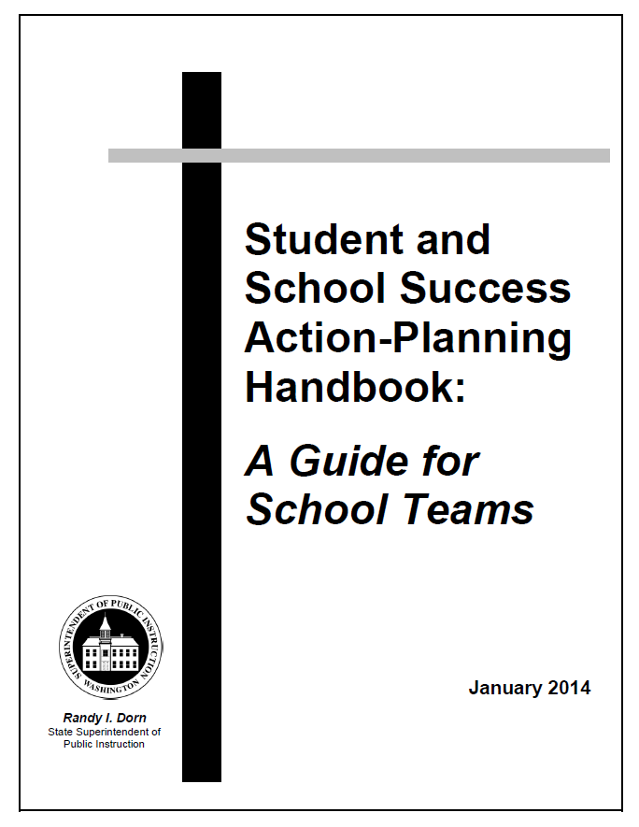
Action-Planning Handbooks
Action-Planning Handbook for School Teams and their Districts to:
-increase educator capacity
-improve student achievement
-use the Indistar action-planning tool to assess, create, & monitor their Student and School Success Action Plan.
Notes:
Guidance for Districts with Priority and Focus Schools to assist schools and their districts to (a) examine ways they can most effectively increase educator capacity and improve student achievement; (b) use the Indistar® action-planning tool to assess, create, implement, monitor, and revise their Student and School Success Action Plans; and (c) utilize Indistar® to integrate their Title I Schoolwide Plan with their Student and School Success Action Plan.

Slide 39
Current Practices and Next Steps
Essential Question: What coaching moves do Success Coaches/ESD Leads implement to disrupt and dismantle inequitable practices and systems so that all students achieve to high levels?
Coaching Moves
  Strengthen the core instructional program
  Use multiple sources of data
  Apply research and evidence-based practices
Success Criteria
Notes:
We have the following in place:
Success Coaches (Leadership and Instructional) provide support to individual schools based on the unique needs of students and staff
Leadership Coaches: 1:1 Support to Principals to improve overall student achievement
Instructional Coaches: Professional Learning and Technical Assistance to school staff
Multi Tiered Systems of Support (MTSS) – Our Office and OSPI
Training Model for Success Coaches
Service Delivery and Accountability System
We are working on:
Data analysis, focused on deep level of disaggregation
Integrating our efforts with other divisions in OSPI and Regional ESDs
Increase Parent/Family engagement in turnaround efforts
Use data to surface inequitable outcomes
Engage partners in our action-planning efforts at state and local levels

Slide 40
Questions & Answers

Slide 41
Thank you

Slide 42
OSPI Office of Student and School Success
For more information, please visit our website:
www.k12.wa.us/StudentAndSchoolSuccess
For Questions, please call:
360-725-4960 or
Send us an email at:
studentandschoolsuccess@k12.wa.us

Slide 43
Office of Student and School Success
Multi-Tiered Framework – ALL SCHOOLS
All schools/districts begin at the “All Schools” tier and perform the actions listed.
All schools/districts identified as Priority/Focus/SIG/RADI/ RADII implement additional actions listed per designation.
REQUIRED ACTION DISTRICT LEVEL II
DIRECTED
REQUIRED ACTION DISTRICT LEVEL I
LESS LOCAL
PRIORITY, FOCUS, AND SCHOOL IMPROVEMENT GRANT (SIG) SCHOOLS & DISTRICTS
ACTIONS
AUTONOMY
-Provide districts & schools
with comprehensive
assessment system and annual
Report Card to monitor
student achievement
-Implement system of general
support, targeted assistance,
recognition, and if needed,
intervention for schools & districts
-Monitor & Revise our system of
recognition, targeted assistance, and
intervention to increase effectiveness
and impact
-Provide incentives and support for
continuous improvement in all schools
-Review and approve school & district
improvement plans for schools receiving
categorical funding
-Recognize high performance and progress
-Analyze district conditions to
determine impact on student
achievement (e.g., closing
Achievement Gaps)
-Complete needs assessment
using Report Card and other data
-Monitor and revise district &
school improvement plans
-Build system-wide capacity to
support continuous improvement of
educator practice & student learning
-Implement Teacher Principal
Evaluation Project (TPEP), WA State
Learning Standards, Smarter Balanced
Assessments, & Multi-Tiered System of
Support (MTSS)
-Implement Evidence-Based Interventions
(Turnaround Principles)
-Utilize Action-Planning Tool (Indistar®) Optional
-Support schools to effectively
develop and implement
improvement plans
-Build school and district capacity to
implement TPEP, Washington State
Learning Standards, Smarter
Balanced Assessments, and MTSS
-Revise plans based on current data
and research
-Review policies, procedures & practices
to address inequitable student outcomes
-Build system-wide capacity to support
continuous improvement of educator
practice and student learning
-Engage school and district teams in
implementing Turnaround Principles using
online tool (Indistar® ) Optional
-Access regional and state resources
-Offer online & other resources to
support implementation of TPEP,
State Learning Standards,
Smarter Balanced Assessments,
and MTSS
-Provide Framework of research-
based practices (Turnaround
Principles) & Continuous
Improvement Process/Tool (Indistar®)
-Coordinate across OSPI divisions, ESDs,
and Professional Educator
Organizations to provide coherent
statewide system of support
-Districts implementing Turnaround
Principles & utilizing action-planning
tool (Indistar®): Offer limited
additional support
TARGETED
MORE LOCAL
ALL SCHOOLS & DISTRICTS
STATE ACTIONS
SCHOOL & DISTRICT ACTIONS
SCHOOL & DISTRICT ACTIONS
STATE ACTIONS
RECOGNITION & ACCOUNTABILITY
ASSISTANCE & INTERVENTION
2-10-15 | dg
Notes:
The “All Schools” tier describes state and district/school actions for all schools and districts across Washington State. Similar to a multi-tiered system of supports, these actions are provided to and expected of the state and all of our schools and districts. These are similar to the “Core” that would be represented in the first level of a multi-tiered system of academic and social-emotional supports.
Leaders at the state level, as well as at the district and school levels, are expected to engage in and provide these supports and services to build educator capacity and increase student learning.

Slide 44
Office of Student and School Success
Multi-Tiered Framework - PRIORITY, FOCUS, AND SCHOOL IMPROVEMENT GRANT (SIG) SCHOOLS
All schools/districts begin at the “All Schools” tier and perform the actions listed.
All schools/districts identified as Priority/Focus/SIG/RADI/ RADII implement additional actions listed per designation.
REQUIRED ACTION DISTRICT LEVEL II
DIRECTED
REQUIRED ACTION DISTRICT LEVEL I
LESS LOCAL
-Identify Priority, Focus, and
SIG Schools
-Provide data system to
support school improvement
-Monitor implementation &
impact of district and
school action plans (Indistar®)
-Examine district iGrant budgets
for alignment to approved plan
-Analyze variety of performance
data to determine impact and
identify additional interventions
-Recognize high performance and
progress
-SIG: Ensure school/district
implements Intervention Model
consistent with federal guidelines
-Assess/Implement school
& district Expected
Indicators and Turnaround
Principles
-Create action plans using
Indistar® and monitor changes
in educator practice & student
learning
-Review, revise, & refocus
district policies & procedures
to ensure identified schools
receive support to turn around
performance
-Ensure school implements &
monitors action plans, and uploads
evidence of impact
-Access differentiated services
-Provide resources to implement plans
and build sustainable change
-SIG: Ensure school/district implements
Intervention Model consistent with
federal guidelines
-Focus on changes in educator
.practice essential to boost
student learning and eliminate
opportunity gaps
-Conduct instructional program
review
-Engage with Coaches to build
leadership and instructional
capacity
-Access specialized Professional
Learning to support educators
-Engage school community in
improvement process
-Implement & Monitor school &
district improvement plans and identify
additional resources needed to improve
educator practice
-District: Differentiate assistance and
intervention to identified schools based
on unique needs
-Allocate resources (iGrants,
Leadership coaches)
-Provide ongoing, job-
embedded PD/TA to increase
educator capacity for
transformational teaching for
learning
-Offer technical assistance to
implement action plan (Indistar®)
-Engage district & school teams
through regional convenings and
peer reviews of action plans
-Differentiate services and supports
based on a needs analysis
-Provide guidance to schools &
districts to build systems to sustain
improvements
-Deliver Professional Learning to build
coach capacity
-Conduct Instructional Reviews
-Review & provide coaching comments
and critiques for action plans
ACTIONS
AUTONOMY
TARGETED
MORE LOCAL
PRIORITY, FOCUS, AND SCHOOL IMPROVEMENT GRANT SCHOOLS & DISTRICTS
ALL SCHOOLS & DISTRICTS
STATE ACTIONS
SCHOOL & DISTRICT ACTIONS
SCHOOL & DISTRICT ACTIONS
STATE ACTIONS
RECOGNITION & ACCOUNTABILITY
ASSISTANCE & INTERVENTION
2-10-15 | dg
Notes:
The second tier describes supports and services for “Priority, Focus, and School Improvement Grant Schools.” These schools engage in actions described in both the “All Schools” tier and this second tier. These schools receive direct service and supports through the Office of Student and School Success.
Priority, Focus, and SIG schools were identified by the state as needing additional supports and services based on the performance of their students on state assessments and/or graduation rates. The goals for these supports and services are to build educator and system capacity at the district and school levels so that student learning increases significantly and these schools exit their status as a Priority school, Focus school, or School Improvement Grantee.
Leaders at the state level, as well as at the district and school levels, are expected to engage in and provide these supports and services to build educator capacity and increase student learning.

Slide 45
Office of Student and School Success
Multi-Tiered Framework – REQUIRED ACTION DISTRICT LEVEL I
All schools/districts begin at the “All Schools” tier and perform the actions listed.
All schools/districts identified as Priority/Focus/SIG/RADI/ RADII implement additional actions listed per designation.
REQUIRED ACTION DISTRICT LEVEL II
DIRECTED
LESS LOCAL
-Identify RAD Level I
-Conduct Academic
Performance Audit/System
Review & Comprehensive Data
Review
-Review/Approve school &
district RAD action plans
-Monitor plans & report progress
to State Board of Education (SBE)
at least two times per year
-Utilize variety of data to assess
implementation
-Ensure implementation of
federal/state model requirements
-Implement state-level
recommendations from Academic
Performance Audit
-Implement school &
district requirements from
Academic Performance
Audit
-Implement federal/state
Intervention Model and RAD
action plans
-Follow iGrant assurances
-Negotiate Memorandum of
Understanding, if needed
-Monitor & Revise action plans to
close opportunity gaps
-Engage in required Professional
Learning aligned with RAD plan
-Ensure clear focus on
leadership, instruction, data
use, interventions, & support
systems
-Engage school & district educators
in turnaround practices
-Provide assistance and intervention
to support school & district RAD
action plans
-Review plan prior to SBE review and
revise as needed to align with
requirements
-Identify and Support
implementation of
requirements from Academic
Performance Audit
-Allocate resources to support
effective implementation of
Intervention Model
-Provide Professional Learning to
implement Intervention Model
-Engage in on-site monitoring and
Professional Learning to increase
educator capacity to implement
action plan
ACTIONS
AUTONOMY
TARGETED
MORE LOCAL
REQUIRED ACTION DISTRICT LEVEL I
PRIORITY, FOCUS, AND SCHOOL IMPROVEMENT GRANT (SIG) SCHOOLS & DISTRICTS
ALL SCHOOLS & DISTRICTS
ALL SCHOOLS
STATE ACTIONS
SCHOOL & DISTRICT ACTIONS
SCHOOL & DISTRICT ACTIONS
STATE ACTIONS
RECOGNITION & ACCOUNTABILITY
ASSISTANCE & INTERVENTION
2-10-15 | dg
Notes:
The third tier, “Required Action District Level I,” describes actions for Washington State’s 8 Required Action Districts and their identified schools.
In the 2011-12 school year, the State Board of Education designated four districts and their identified schools for Required Action based on persistently low and declining performance on state assessments in their identified school. These districts are eligible to exit Required Action status effective 2015-16; the determination will be based on several factors, including student performance on state assessments for the previous three years. In spring 2014, four additional districts were designated for Required Action by the State Board of Education.
Note that Required Action Districts and their identified schools engage in all actions in the first three tiers.
Leaders at the state level, as well as at the district and school levels, are expected to engage in and provide these supports and services to build educator capacity and increase student learning.

Slide 46
Office of Student and School Success
Multi-Tiered Framework – REQUIRED ACTION DISTRICT LEVEL II
All schools/districts begin at the “All Schools” tier and perform the actions listed.
All schools/districts identified as Priority/Focus/SIG/RADI/ RADII implement additional actions listed per designation.
-Identify RAD Level II
-Collaborate with
school & district to
develop Level II
Required Action Plan
-Direct needs assessment
to identify why previous
plan did not succeed
-Identify potential binding
conditions
-Reallocate
funds, if needed
-Collaborate with OSPI to develop
Level II Required Action Plan
-Re-open or Negotiate an addendum to
Collective Bargaining Agreement, if needed,
regarding conditions of employment
-Provide explicit reasons why previous plan did
not succeed and specify new interventions
-Adhere to binding conditions, if needed
-May assign on-site
school improvement
specialist
-Withhold state funding
allocation if binding
conditions are not met
DIRECTED
LESS LOCAL
REQUIRED ACTION DISTRICT LEVEL II
REQUIRED ACTION DISTRICT LEVEL I
ACTIONS
AUTONOMY
PRIORITY, FOCUS, AND SCHOOL IMPROVEMENT GRANT (SIG) SCHOOLS & DISTRICTS
TARGETED
MORE LOCAL
ALL SCHOOLS & DISTRICTS
ALL SCHOOLS
STATE ACTIONS
SCHOOL & DISTRICT ACTIONS
SCHOOL & DISTRICT ACTIONS
STATE ACTIONS
RECOGNITION & ACCOUNTABILITY
ASSISTANCE & INTERVENTION
2-10-15 | dg
Notes:
The smallest tier describes actions for districts and their identified schools designated by the State Board of Education as requiring significant intervention and support. This tier applies to those rare cases of districts with a persistently lowest achieving school that continues to fail to improve even after required action and enhanced supplemental assistance. During its 2012 session, the legislature enacted legislation (E2SSB 5329) that states for these districts and their identified school, “It is appropriate and necessary to assign the superintendent of public instruction the responsibility to intercede, provide robust technical assistance, and direct the necessary interventions.” To date, no districts have been identified as Level II Required Action Districts.

